Slide 1
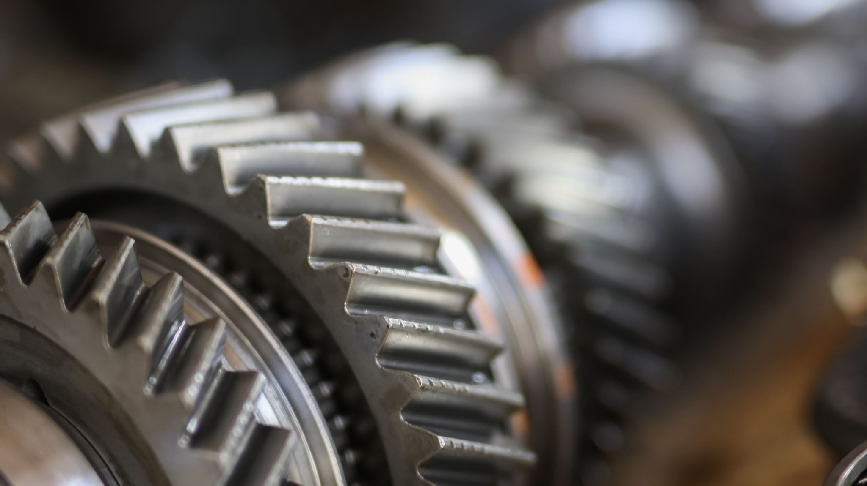
Registering Aircraft Parts Smart Contract
Fintech Bootcamp Project #3
Jabin Barcelo, George Murnane, Sebastian Ramirez, Kristina Valenzuela

Slide 2
Blockchain in Aviation
Aviation blockchain market is projected to grow from USD 421 million in 2019 to USD 1,394 million by 2025 driven by the increased transparency and traceability and improved passenger experience the blockchain market provides
Most of this growth is in the commercial airline and air travel industries
Numerous airlines, aircraft Maintenance, Repair and Overhaul (MRO) providers, and aircraft manufacturers have announced research programs & initiatives that use blockchain to manage the purchase of flight tickets, reduce wait times, speed the delivery of parts and ensure accurate tracking or replacement parts

Slide 3
Need for Immutable Record Keeping
A single aircraft can have records scattered across multiple owners and vendors databases:
Maintenance records are in one or more maintenance provider databases;
Registration data is stored at the FAA;
Title, liens, and insurance information are stored with their respective organizations
It’s an inefficient system that doesn’t easily provide a picture of an airplane’s history
A blockchain platform eliminates these and other inefficiencies by connecting all participants to a blockchain

Slide 4
Potential Applications
Passenger Identity Management Cargo & Baggage Tracking Flight & Crew Data Management Frequent Flyer Programs Smart Contract Leasing Travel Insurance E-ticketing & Ticket Tokenization | Aircraft Refueling Airline Revenue Sharing Supply Chain Management Parts Tracking Parts Health Monitoring Inventory Management Aircraft Maintenance

Slide 5
Applications for Aircraft Maintenance
Perhaps the more groundbreaking use of blockchain in aviation is in the overhaul of the record keeping for maintenance and spare parts inventory and replacement
Here are 4 applications for aircraft maintenance:
Making Record Keeping Easier
Linking the Entire Supply Chain
Establishing Trust in the Used Parts Market
Tracking Every Part in Stock

Slide 6
Applications for Aircraft Maintenance
GE Aviation’s Digital Group – provide a platform called TRUEngine, a Microsoft Azure-based blockchain technology, to track the life of each aircraft part, replacing the current paper documentation process which is cumbersome and inefficient
EdgeVerve (US) provides new blockchain-powered application for supply chain management geared towards the aviation market
Honeywell (USA) – Honeywell’s has created GoDirect Trade, a blockchain platform designed to prove the origin of the parts and ensure they comply with safety standards (Boeing has added more than $1 billion in excess airplane parts to the platform)
14bis Supply Tracking – provides digital and physical asset management platform that provides provenance of aerospace parts from the factory to disposal.

Slide 7
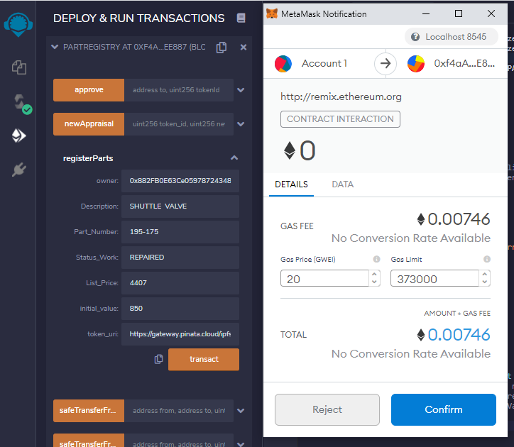
ERC-721
Non-Fungible ERC-721 is a free, open standard that describes how to build non-fungible or unique tokens on the Ethereum blockchain.​
A Non-Fungible Token (NFT) is used to identify something in a unique way. ​
ERC-721 tokens are all unique like rare, one-of-a-kind collectables unlike ERC-20 that are identical.​

Slide 8
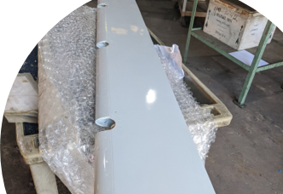
Why ERC-721 for plane parts?​
All NFTs have a uint256 variable called tokenId, so for any ERC-721 Contract, the pair contract address, uint256 tokenId must be globally unique. ​
Using NFTs allows us to create a clear record of aircraft parts by creating an NFT that represents each part and stores necessary information for inventory/records.​

Slide 9
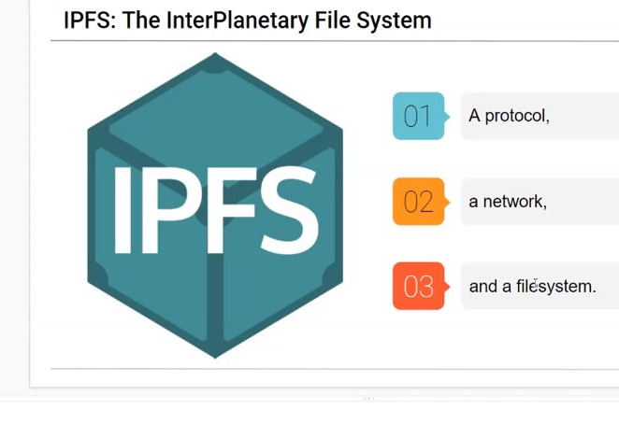
InterPlanetary File System
Using the IPFS, we can retrieve our data by its content and not it's location. The IPFS version of the data is represented by a string of numbers. The computer uses IPFS asks various computers around the world to then share the page.

Slide 10
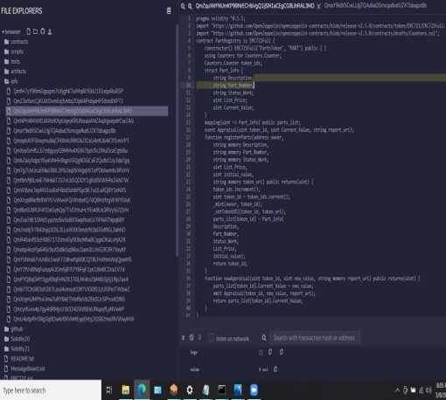
Hash Identification
The content identifier is a cryptographic hash of the content at that address. The hash is unique to the content that it came from, even though it may look short compared to the original content.​

Slide 11
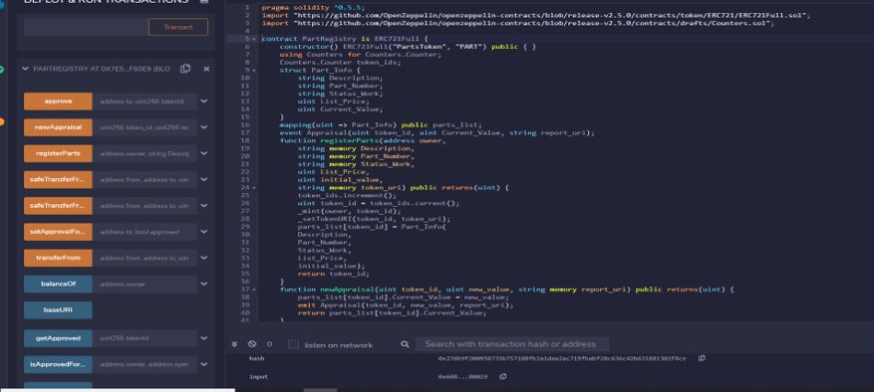
Contract Screenshot

Slide 12
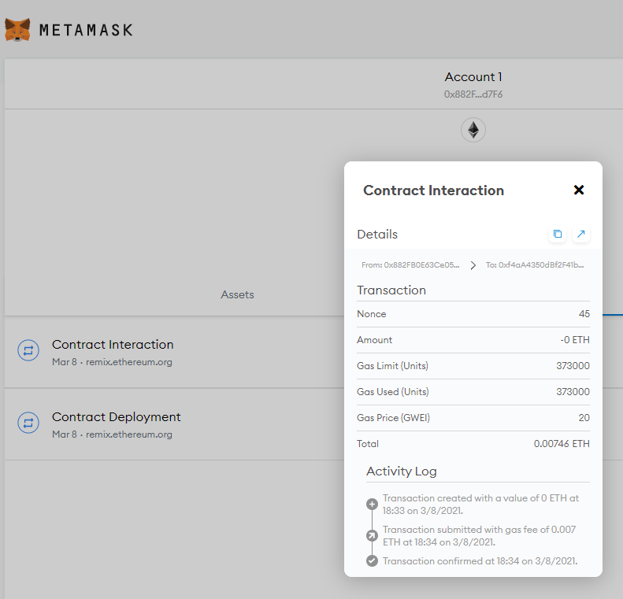
Deploying Contract in MetaMask
373000 units of gas
Gas Price 20GWEI
Total - .00746 ETH

Slide 13
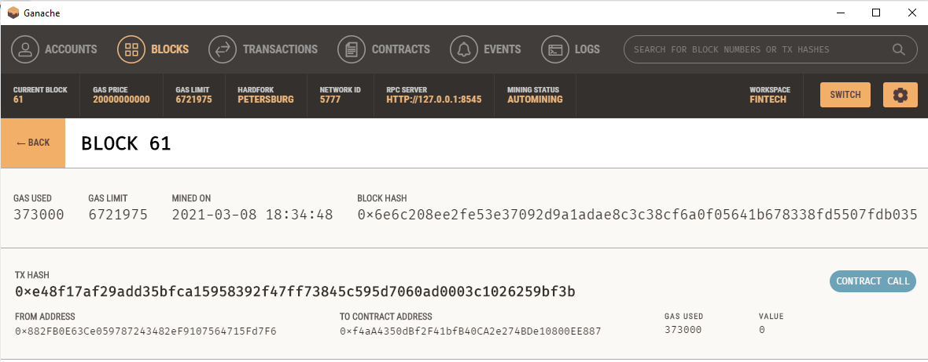
Viewing Contract in Ganache

Slide 14
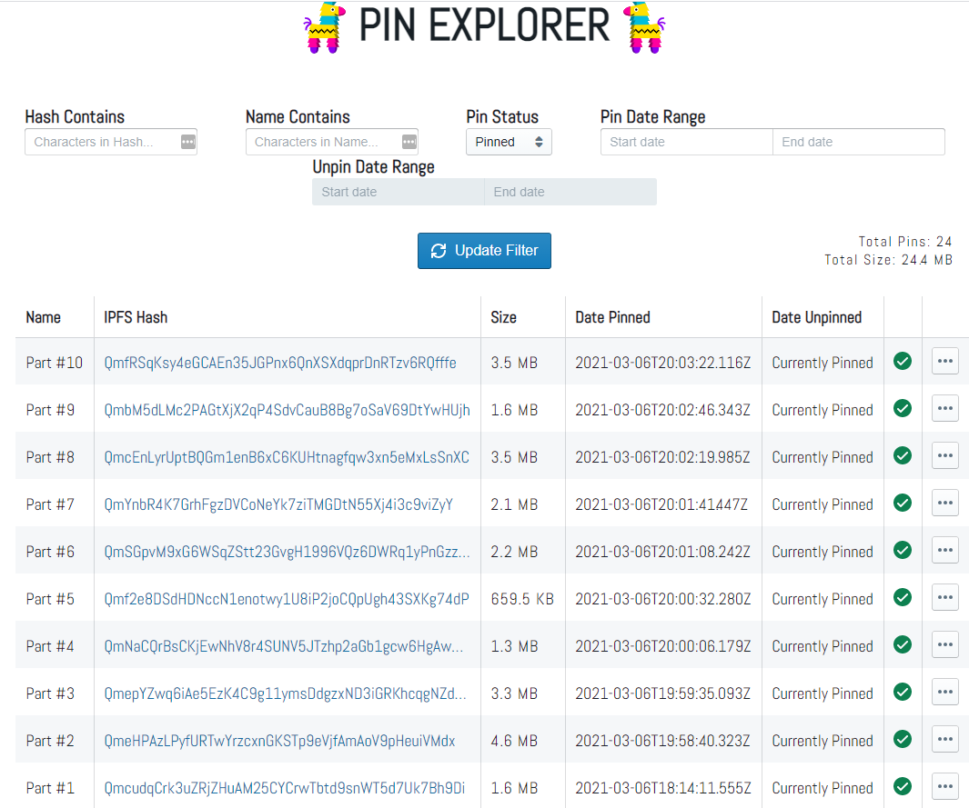
IPFS Hash Creation
We used Piñata to store the detailed parts documentation for each registered part

Slide 15
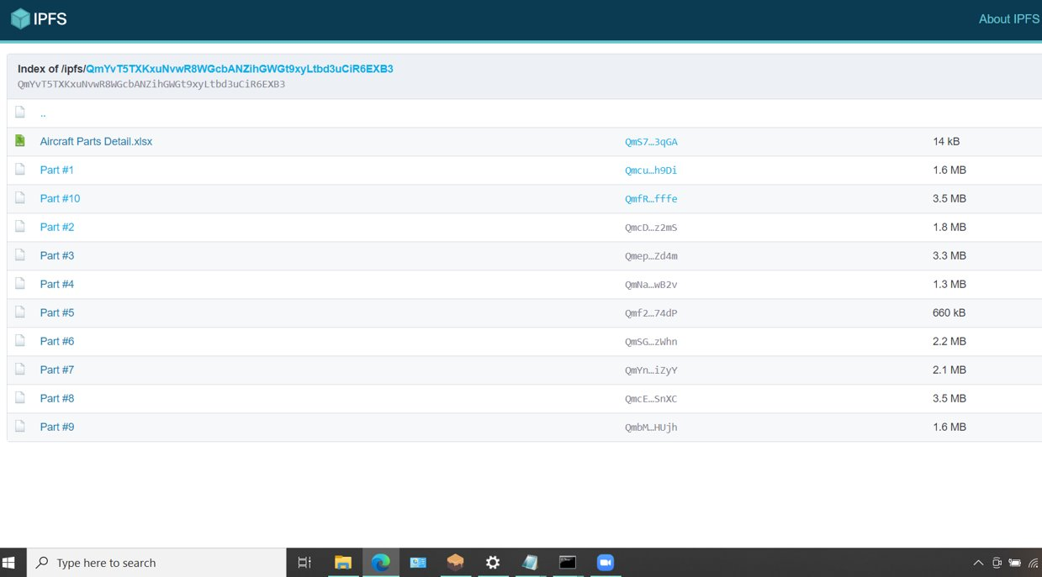
IPFS Storing Full Directory Of Parts Info

Slide 16
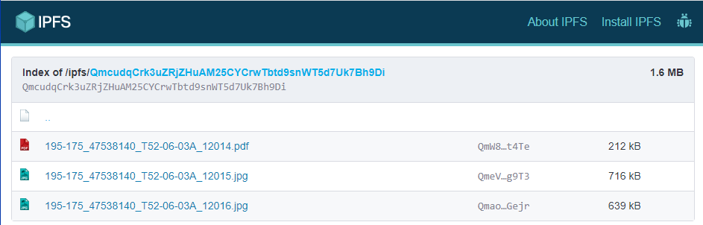
IPFS Storing Directory of a Single Part’s Data

Slide 17
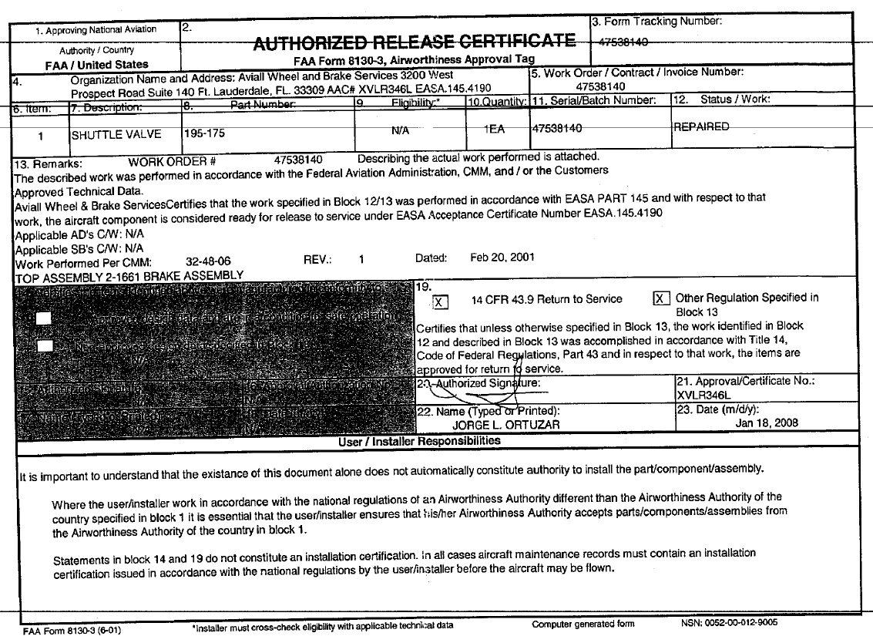
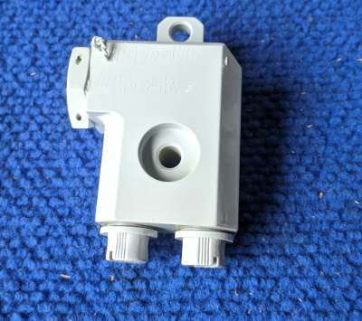
Content Loaded

Slide 18

Challenges
Original plan: create a crowd funding site with registered investors. Once we realized the protocol for fungible tokens did not accommodate registration data, we moved to non-fungible parts registration.
Next challenge: create a front-end interface to register the parts, but we were unable to modify the index and dapp files as those were outside the scope of the class.

Slide 19
Sample Dataset in Excel
Authorized Release Certificate | Organization Name | Description | Part Number | Serial/Batch # | Status / Work | List Price | Current Value
FAA Form 8130-3 | Aviall Wheel and Brake Services | SHUTTLE VALVE | 195-175 | 47538140 | REPAIRED | $ 4,407 | $ 850
BCAA Form 003 | EMBRAER | WINDSHIELD, LH, GLASS, HEAT | NP-187301-15 | 13096H2221 | NEW | $ 36,799 | $ 30,000
FAA Form 8130-3 | AERO INSTRUMENTS & AVIONICS | PITCH CTRL. CHANNEL | 2585804-4 | 0211642 | OVERHAULED | $ 13,447 | $ 1,500
FAA Form 8130-4 | AIRFRAME INTERNATIONAL, INC. | CONTROL TAB ASSY LH | 5910413-501 | 1208AL | REPAIRED | $ 18,900 | $ 1,500
FAA Form 8130-5 | PARAMOUNT AVIATION | CARRIER | 680468-1 | NSN | UNK | $ 2,251 | $ 175
FAA PART 125 AIRLINE CERT | ARAMCO ASSOCIATED COMPANY | PIPE CASE DRAIN | 15E805001 | UNK | SERVICEABLE | $ 11,392 | $ 10,000
EASA FORM 1 | ANTAVIA | ELECTRICAL COCKPIT DOOR LATCH | AS-200-00075 | 0715 | REPAIRED | $ 7,789 | $ 5,000
EASA FORM 1 | HAMILTON SUNSTRAND | DUAL HEAT, EXCHANGER | 1001858-2 | 0652 | REPAIRED | $ 93,457 | $ 65,000
FAA Form 8130-9 | BFGOODRICH | LINK ASSEMBLY | 65-19657-19 | DL113 | OVERHAULED | $ 1,129 | $ 1,000
GE FORM GT2972-7 | GE ENGINE SERVICES DISTRIBUTION | ACCLRMTR | 4119T33P03 | VBRBM798 | NEW | $ 17,256 | $ 15,500

